Slide 1
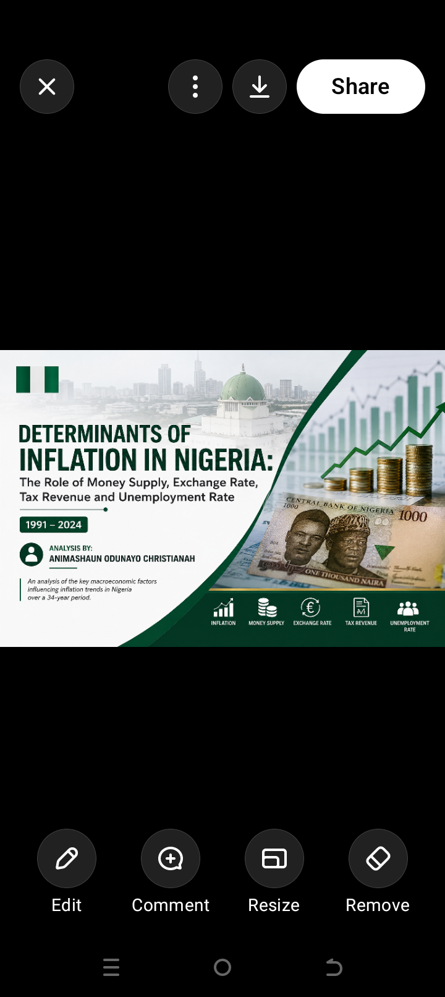

Slide 2
Background of the study
Inflation is one of the major economic challenges facing Nigeria ,Inflation is the sustained increase in the general price level of goods and services
It affects:
Household purchasing power
Cost of food and transportation
Business operating costs
Savings and investment
Interest rates
Government spending
Exchange rate stability
Overall economic welfare
Nigeria has experienced periods of both moderate and extremely high inflation particularly during periods of economic and currency instability
When prices continuously increase the same amount of money buys fewer goods and services Understanding what is associated with inflation can therefore help policymakers and businesses make better decisions

Slide 3
About the Dataset
The dataset used for this analysis was sourced from the World Bank ,specifically covering Nigerian macroeconomic indicators from 1991 to2024 is contains annual real-world macroeconomics observation for Nigeria
It contains annual observations for key economic variables used to examine Nigeria’s inflation dynamics
From World Bank
Inflation rate –The main outcome
Money supply –Used to examine the relationship between Monetary expansion and inflation
Exchange Rate –Used to assess the relationship between naira depreciation and inflation
Tax Revenue- Used to examine the relationship between government revenue and inflation
Unemployment-used to assess the relationship between labour market conditions and inflation

Slide 4
Problem Statement
Nigeria has experienced significant fluctuations in inflation over the past three decades
Despite various monetary and fiscal policies inflation has remained a persistent economic challenge
However ,the relative relationship between these variables and inflation can be difficult to understand when looking at individual figures separately
Persistent inflation reduces household purchasing power, increases the costs for businesses. Understanding the factors associated with inflation is therefore important for policymakers, businesses and households
Key problem
There is a need to analyse historical macroeconomic data together to identify patterns and relationships that can provide a clearer understanding of Nigeria’ inflation dynamics
"The main problem is that inflation in Nigeria has been changing significantly over the years and it affects people's everyday lives. We therefore want to understand whether factors such as money supply, exchange rate, tax revenue and unemployment are related to these changes. This analysis uses historical data to identify those patterns."

Slide 5
Aim and Objectives of the study
Aim
The main aim of this study is to examine the major macroeconomics variables associated with inflation in Nigeria between 1991 and 2024 using data analytics techniques
The study seeks to transform historical economic data into meaningful insights that can support economic interpretation and decision making
Objectives
Examine the trend of inflation in Nigeria from 1991-2024
Analyse the relationship between money supply and inflation
Examine the relationship between exchange rate and inflation
Analyse the relationship between tax revenue and inflation
Assess the relationship between unemployment and inflation
Develop an inflation forecast based on historical patterns
Present the findings through an interactive Power Bi dashboard

Slide 6
Research Question
Main Question
What are the relationship between money supply ,exchange rate ,tax revenue and unemployment and inflation in Nigeria from 1991 to 2024
Supporting questions
How has inflation changed between 1991 and 2024
How has money supply evolved over the period?
Is exchange rate depreciation associated with higher inflation?
What relationship exists between tax revenue and inflation
Does unemployment show a strong or weak relationship with inflation
What does the historical trend suggest about future inflation

Slide 7
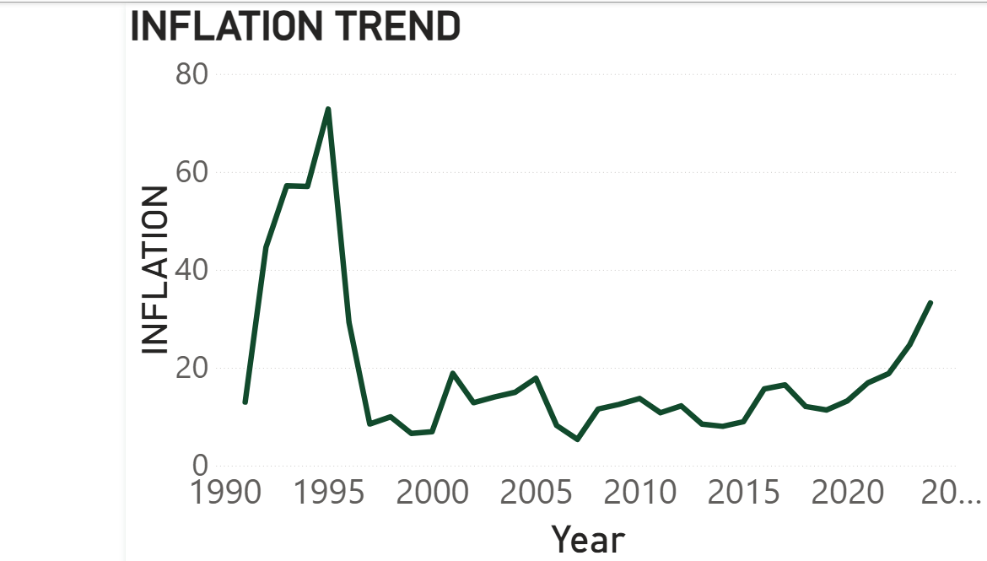

Slide 8
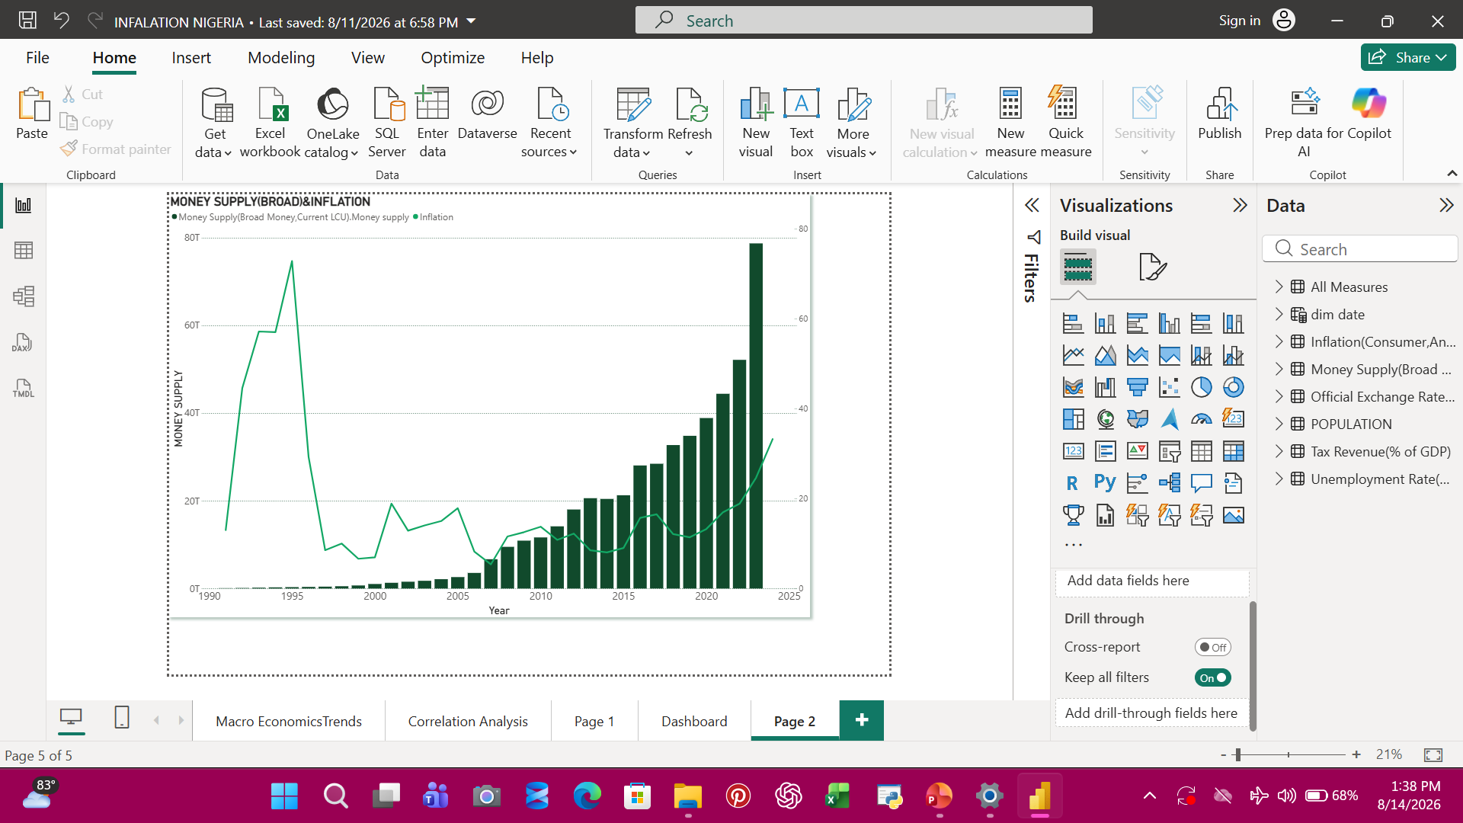

Slide 9
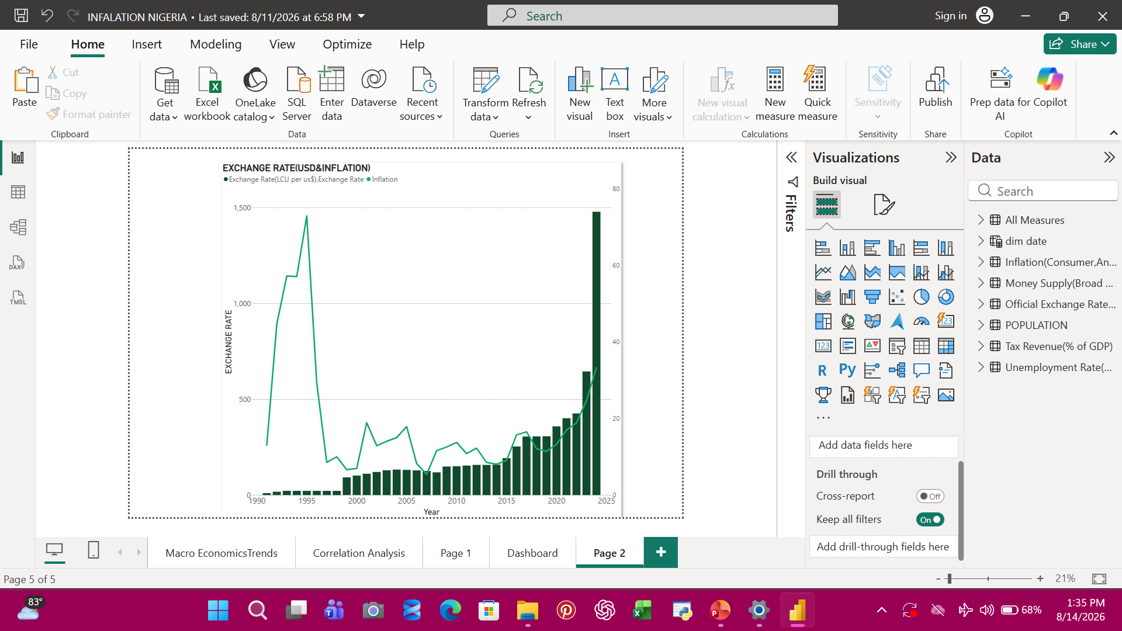

Slide 10
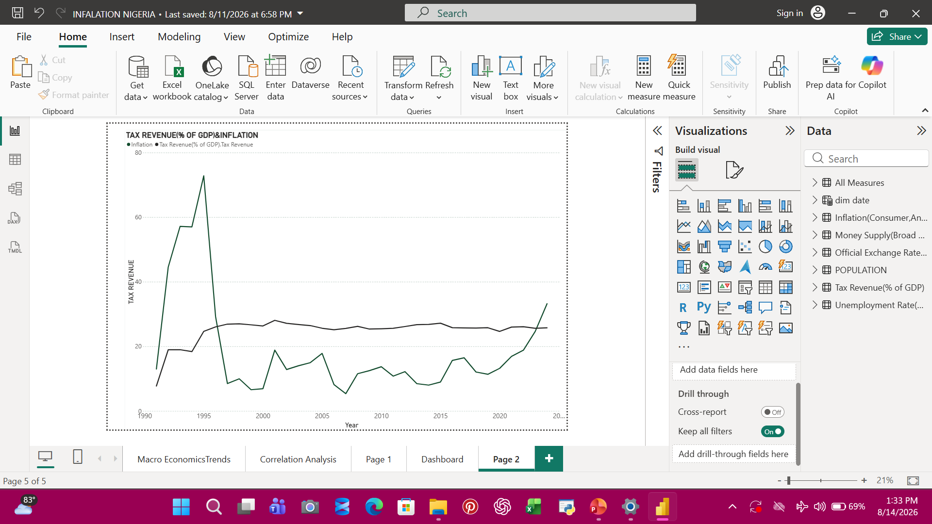

Slide 11
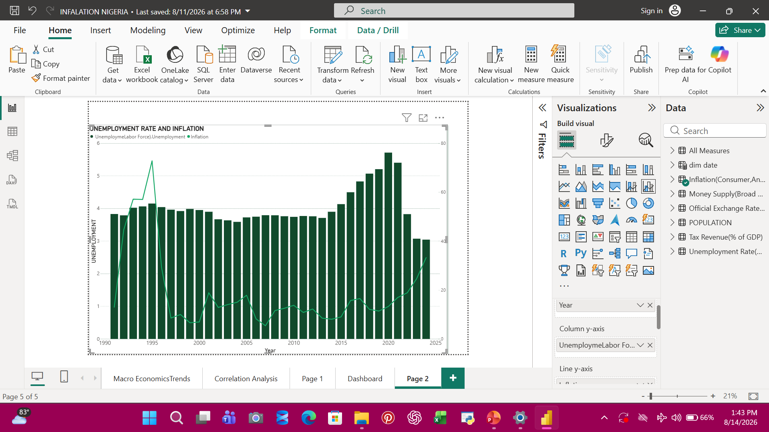

Slide 12
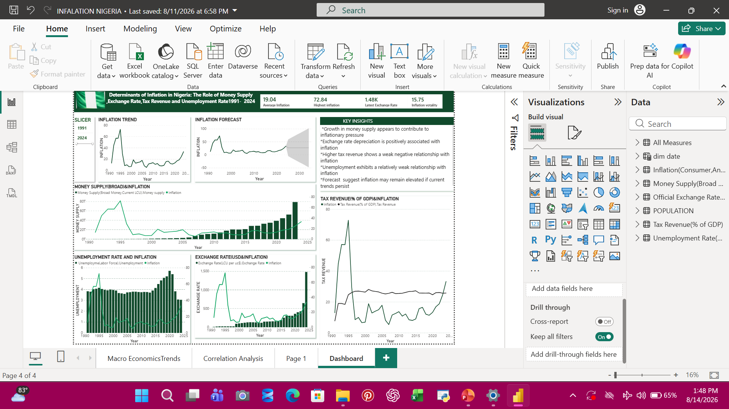

Slide 13
Recommendation
Control rapid increases in money supply Since inflation tends to rise when money supply increases significantly, the government should carefully manage the amount of money circulating in the economy.
Reduce excessive exchange-rate changes The analysis shows that changes in the exchange rate are closely associated with inflation. Keeping the naira more stable can help reduce increases in the prices of imported goods.
Produce more goods locally Nigeria should encourage local production of food, fuel, raw materials and other essential goods. This can reduce dependence on imports and help keep prices more stable.
Support people affected by rising prices When inflation is high, people's money buys less. Government should provide targeted support for vulnerable households while working on the causes of inflation.
Create more jobs Although unemployment showed a weaker relationship with inflation in this dataset, creating more jobs remains important for improving people's income and living standards.
Keep monitoring inflation The analysis and forecast suggest that inflation can remain high. Government should regularly monitor economic indicators and take action when signs of increasing inflation appear.

Slide 14
Conclusion
The analysis examined Nigeria's inflation trends between 1991 and 2024 using World Bank macroeconomic data
The findings show that inflation has experienced significant fluctuations over the period. Money supply and exchange-rate movements show noticeable relationships with inflation, while unemployment and tax revenue show relatively weaker relationships in the dataset.
The analysis also shows that inflation is not influenced by one factor alone. Economic conditions, monetary factors, exchange-rate movements and other factors can work together to influence changes in prices.
The forecast suggests that inflation may remain elevated if existing patterns continue, although there is uncertainty around future outcomes.
Overall, the analysis shows that Nigeria's inflation problem is complex and cannot be explained by a single variable. Monitoring money supply and exchange-rate movements, while improving domestic production and addressing other economic challenges, can contribute to better inflation management.

